Slide 1
GNUplot & PCAP
Discussion Section – May 22

Slide 2
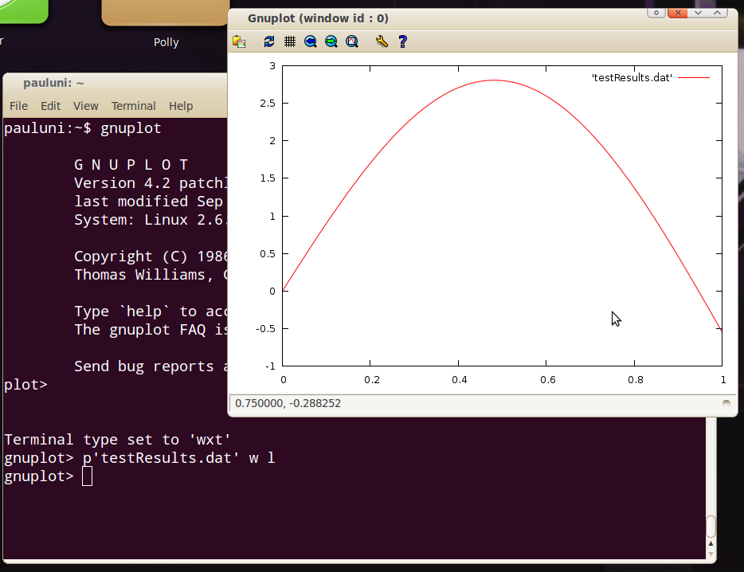
What is GNUplot?
It’s an interactive plotting environment
Can be directly used from Terminal (popular method)
Or can be imported as a module in Python

Slide 3
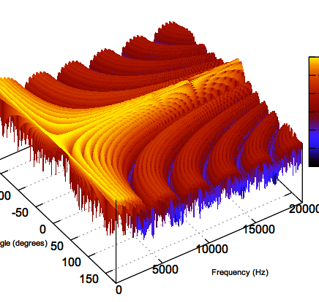
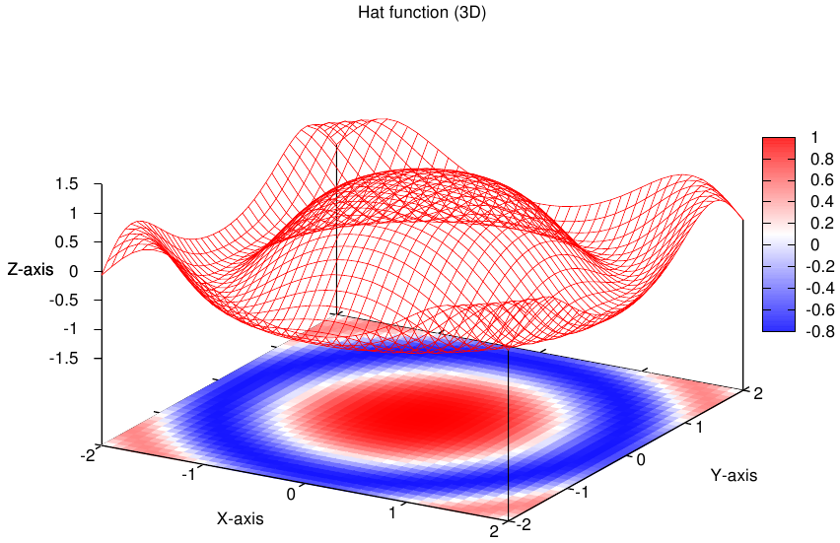
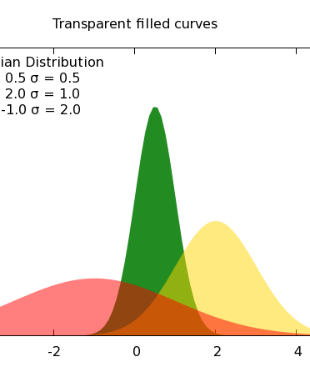
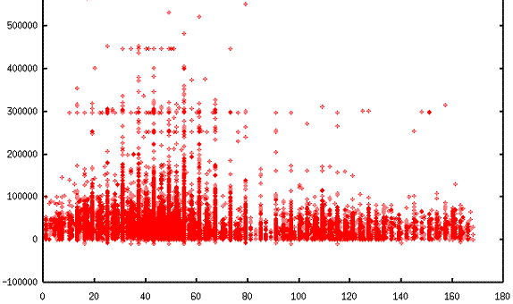
What can you do with GNUplot? > Graph these beautiful plots!

Slide 4
Basic Features
Provides math, string and time functions
Provides block structure if/while/do
Can select a column of data from a data file by matching a label, or by index.
Installing GNUplot:
Windows get .exe from sourceforge.net/projects/gnuplot/files
Mac get .tar.gz from sourceforge.net/projects/gnuplot/files
open shell, go to download directory, type ”configure”, ”make”, ”sudo make install”
Linux use package management system
To start, type “gnuplot” in terminal/cmd
To quit, type “quit”

Slide 5
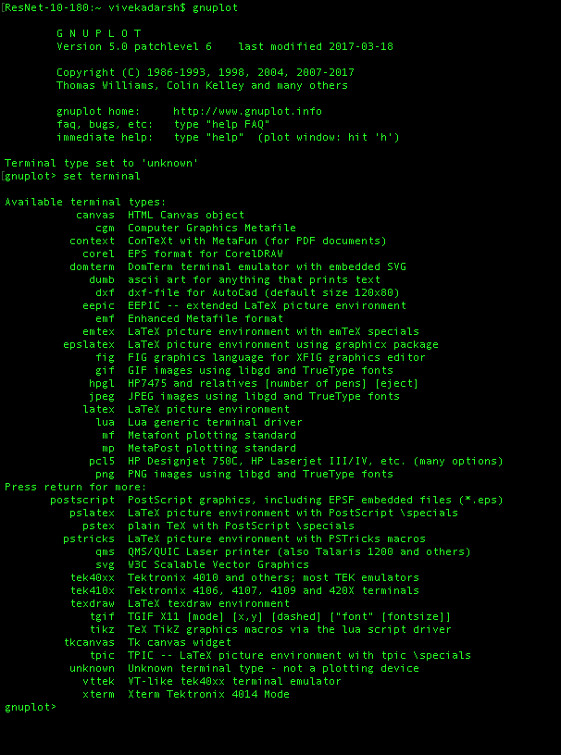
Set the terminal type
gnuplot> set terminal postscript
gnuplot> set terminal png
gnuplot> set output "plot.png"

Slide 6
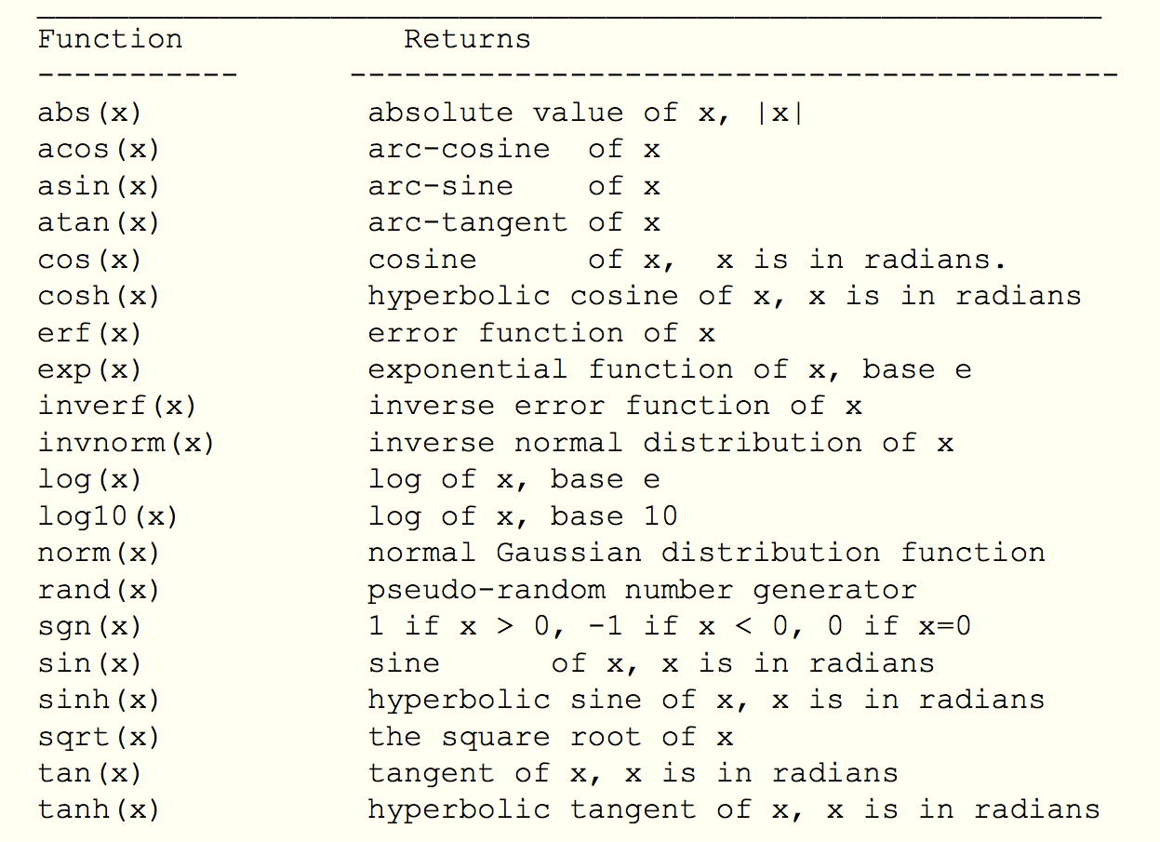
Supported functions
Try this syntax out:
gnuplot> plot (sin(x))
gnuplot> splot sin(x*y/20)
gnuplot> plot sin(x) title 'Sine Function', tan(x) title 'Tangent'

Slide 7
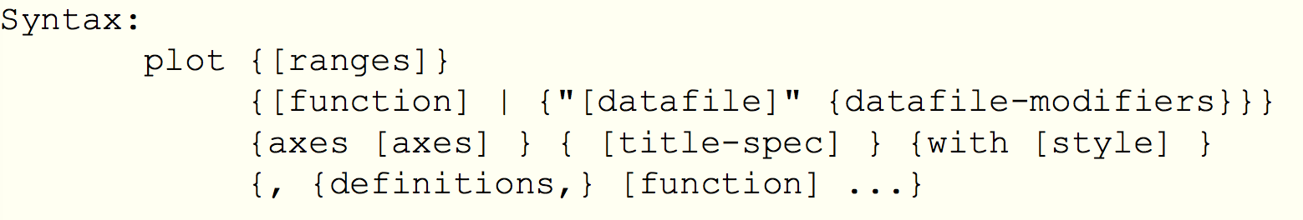
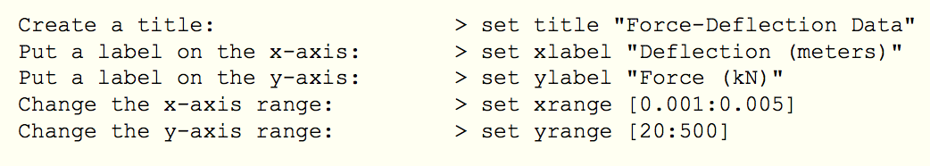
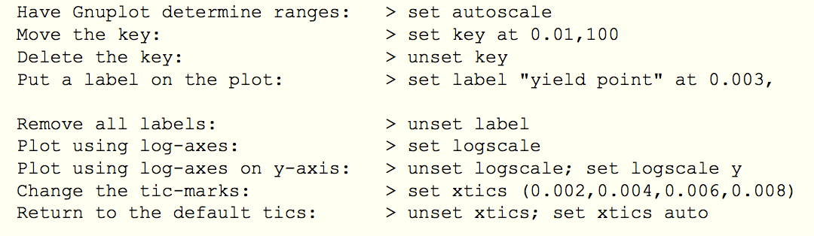
Plotting Data
gnuplot> plot ”example1.dat" using 1:2 title 'Column', \
”example2.dat" using 1:3 title 'Beam'

Slide 8
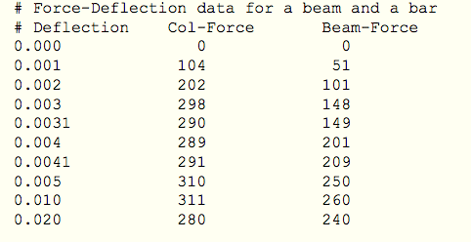
Input *.dat file

Slide 9
Packet Capturing
PCAP == Packet Capture
Complete record of network activity
Layers 2 – 7
Most common format is libpcap
Open-source
Available on Unix and Windows
C library, bindings in many languages
Others proprietary formats not covered

Slide 10
Who Uses PCAP?
Researchers: access to raw data
Administrators: debug network problems
Analysts: characterize malware activity
Incident Responders: follow malware
What would you use it for?

Slide 11
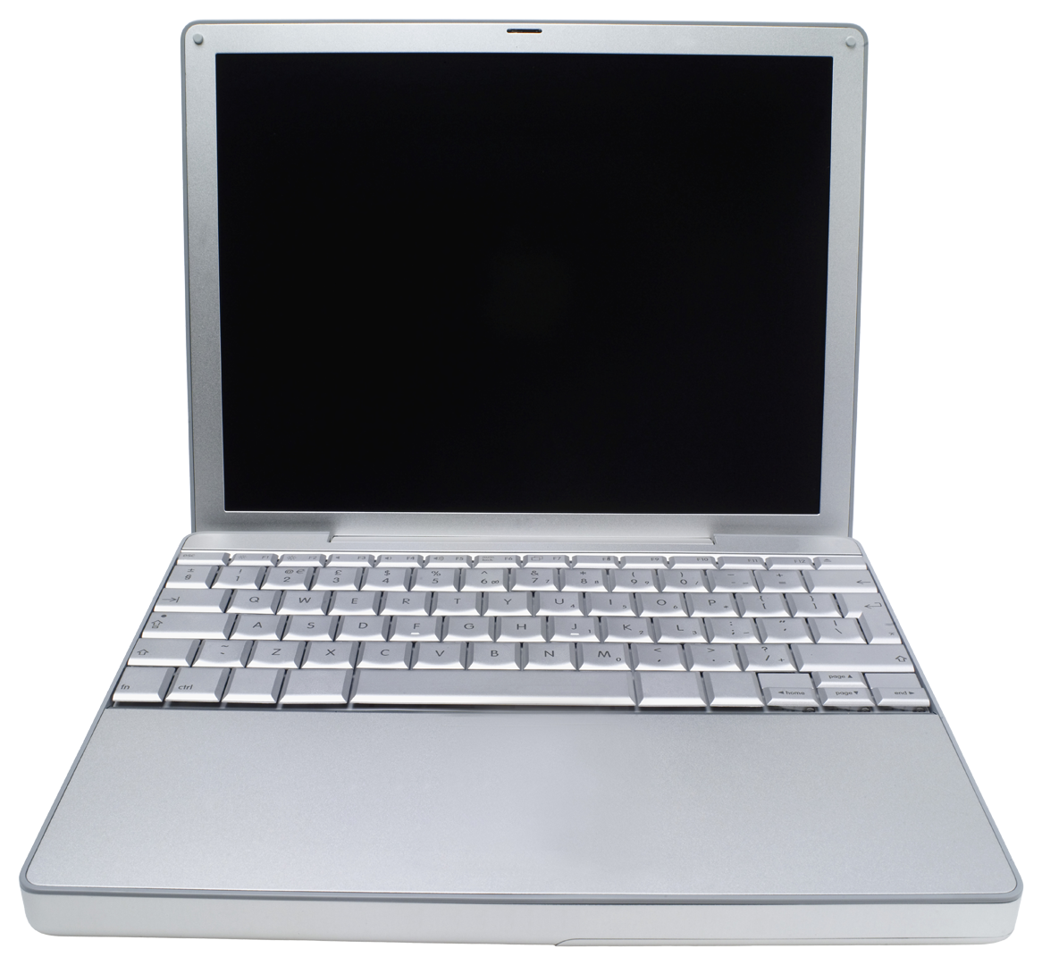
Collecting PCAP
Wireshark
Tcpdump, tshark
Internet
Tap
Packets
Inline Device

Slide 12
Demo time! Wireshark & tcpdump

Slide 13
Useful Resources
Goto gnuplot homepage: http://www.gnuplot.info
Goto gnuplot demos: http://www.gnuplot.info/screenshots/index.html#demos
Goto gnuplot tutorial: http://www.gnuplot.info/help.html
Gnuplot documentation (Most useful!): http://www.gnuplot.info/docs_5.0/gnuplot.pdf
Some of the content have been taken from http://www.usm.uni-muenchen.de/people/puls/lessons/intro_general/gnuplot/gnuplot_for_beginners.pdf
And lastly, YouTube is your friend! There are tons of tutorials available for GNUplot

